Slide 1
Decode 10.3.
Problem statement :Examine the dataset provided, perform EDA. Finally, for the given test dataset, predict whether an individual’s income will be greater than $50,000 per year based on several attributes from the census data.
Tableau dashboard Link: HC | Tableau Public
Submitted By:
Sarvjeet Kour.
Batch: DS21JAN04

Slide 2
Introduction.
The dataset has various features like age, gender, occupation, work class, marital status, etc.
Performed missing value treatment, outlier treatment, EDA, model selection in python.
Compared the performance of various classification models using k-fold cross validation and selected AdaBoost classifier which performed the best.
Performed data visualization using Tableau and compared features with net-income using graphs like bar plot, pie chart, bubble chart, used filters to analyze the data better.

Slide 3
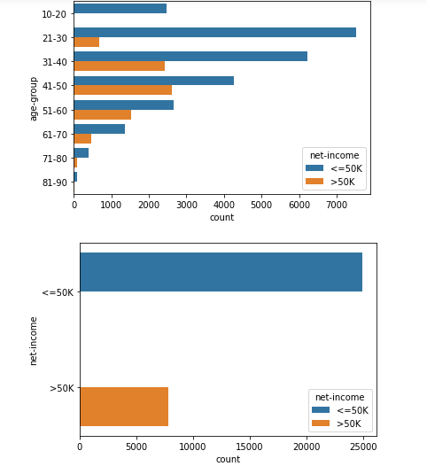
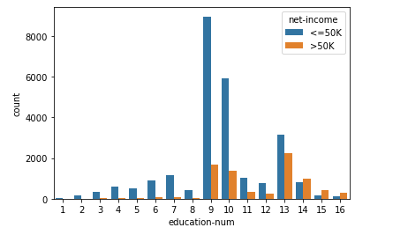
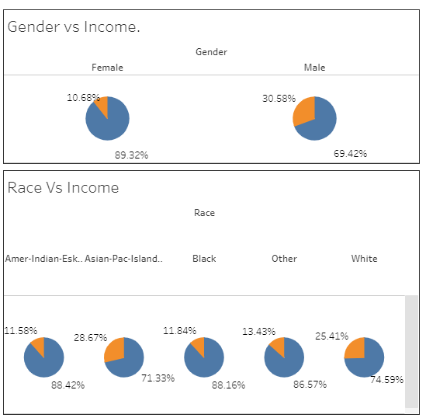
EDA.

Slide 4
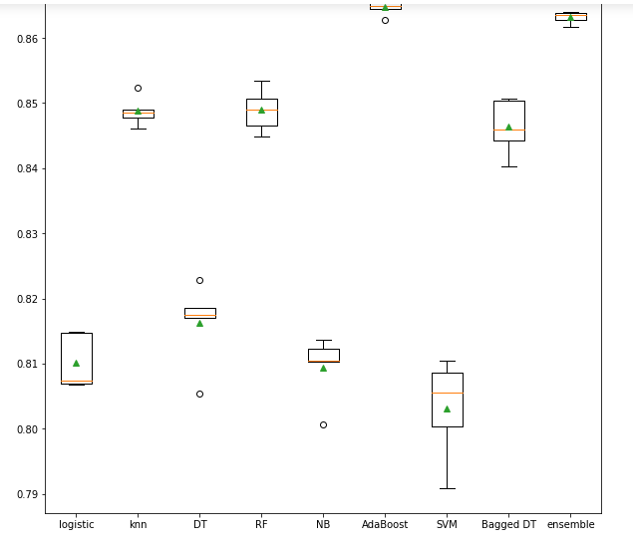
Model performance comparison.

Slide 5
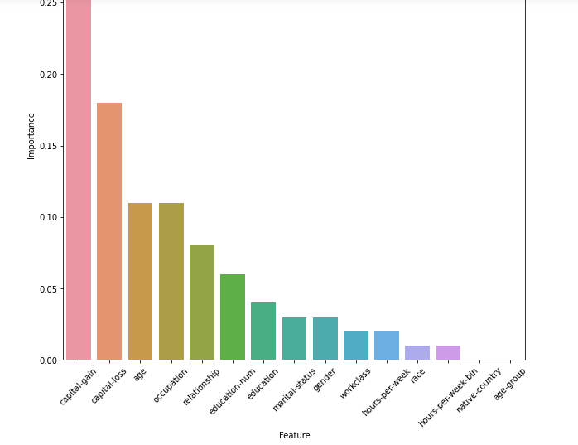
Feature importance.

Slide 6
Conclusion.
work class vs net-income : self-emp-inc, and govt. jobs be it federal, state, gov have higher percentage with income >50K
education vs net-income : If the education is bachelors or higher, the chances are better of earning income >50K
marital-status vs net-income : Married civilian and married armed forces spouse have higher chance of earning income >50K
occupation vs net-income : Exec-managerial and Prof-speciality are the better paid jobs
relationship vs net-income : Married people, both husband and wife have higher proportion of population that have income >50K
race vs net-income : White and Asian-Pac-Islander races have higher chances of earning >50K
gender : Males have higher chances of earning >50K, indicating gender pay gap
native-country : People who natively belong to United States earn more.
hours-per-week-bin : People belonging to higher range bins earn more.
age-group : People in the age group 41-60 have higher chances of earning >50K.

